Slide 1
British Airways Customer Reviews
Key Insights

Slide 2
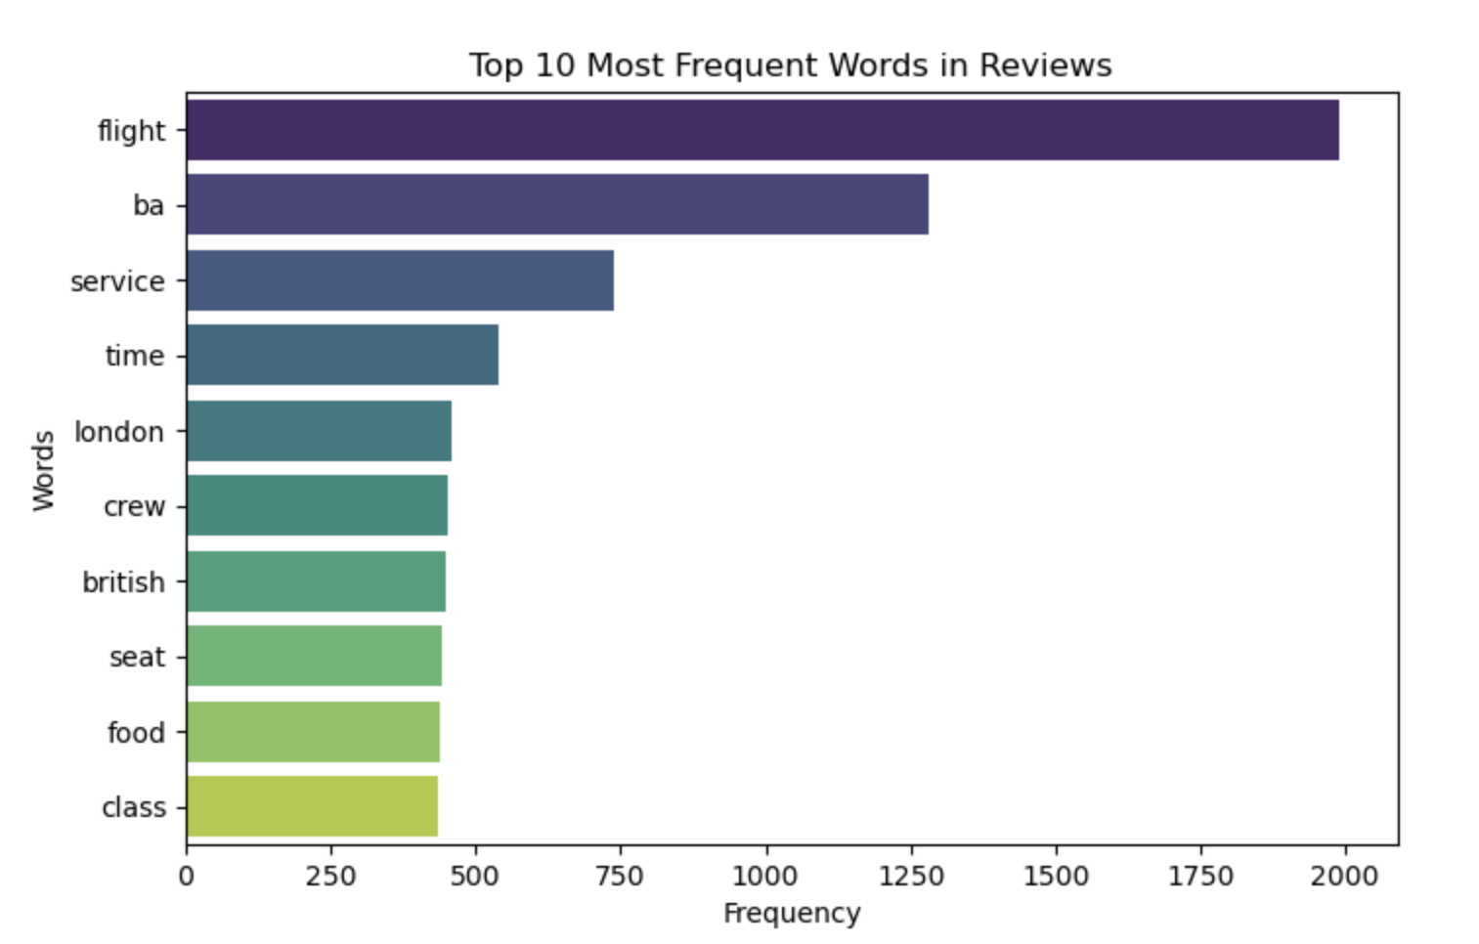
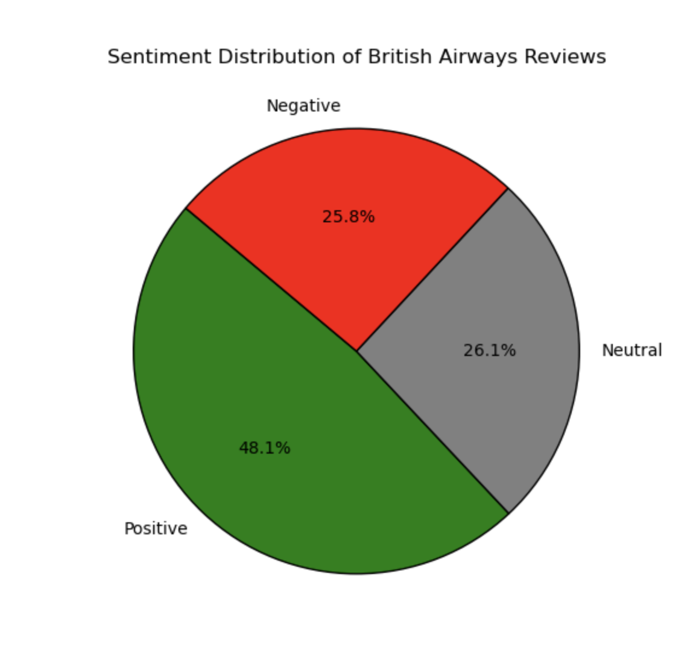
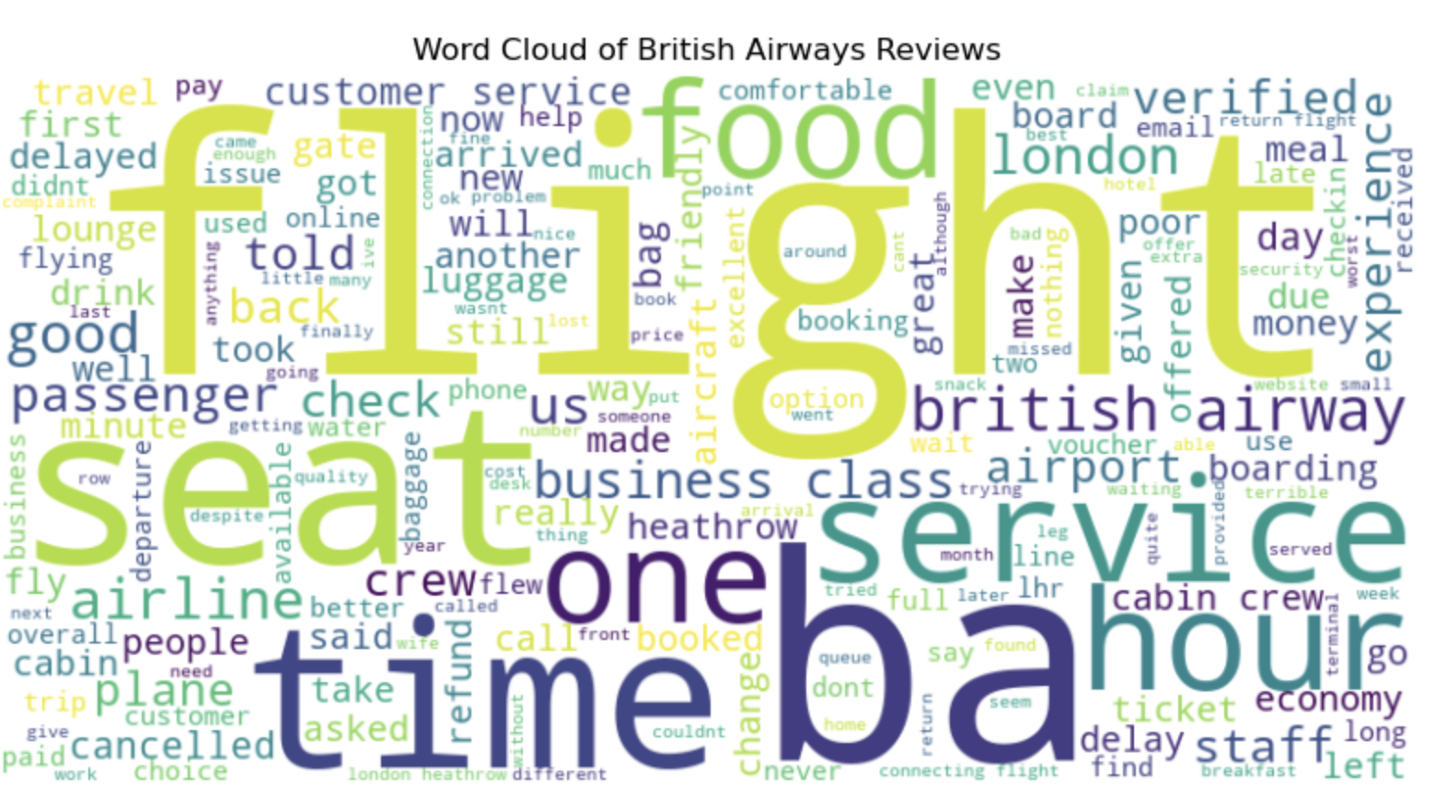
Key Findings:
Sentiment Analysis:
48.1% Positive – Passengers praised service, staff, and comfort.
25.8% Negative – Complaints mainly about delays, cancellations, and baggage handling.
Word Cloud Highlights:
Common words: service, crew, flight, delay, baggage, customer, experience, london
Topic Modeling (Key Themes):
Customer Service – Mixed feedback on responsiveness and attitude.
Flight Delays & Cancellations – A recurring pain point. ( Most of them talks abouot London Flight Delay)
Onboard Experience – Comments on seating, food, and entertainment.
Recommendation:
Improve communication regarding delays.
Enhance baggage handling processes.
Address service inconsistencies for a better customer experience.

